Slide 1
Lecture-6
History of Bengal

Slide 2
Pre-History
Stone Age remnants have been found in Bengal that date back 20,000 years. Regions which have yielded prehistoric artifacts in Bangladesh are the Lalmai hills near Comilla, Chaklapunji Tea Garden of Chunarughat in the Habiganj district of Sylhet, Sitakunda and Rangamati of the Chittagong region, and the Wari-Bateshwar of Narshingdi district. These regions of Bangladesh contain both Pleistocene deposits and suitable raw materials. Wari-Bateshwar, several Neolithic tools such as celts, shouldered axes, etc made on sand stone, silt stone and fossil wood have been found, though their raw materials are not locally available. The most suitable rock in this region is fossil wood and this is what was used as the raw material of the prehistoric industry of Bengal region.

Slide 3
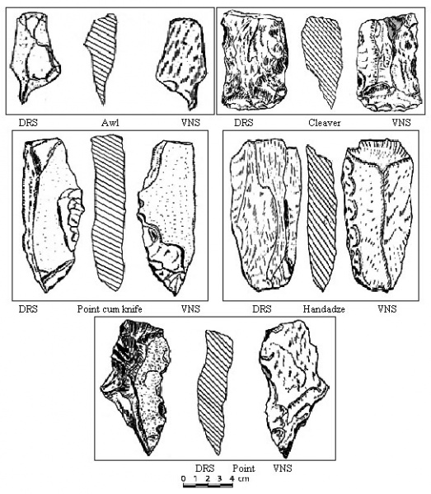
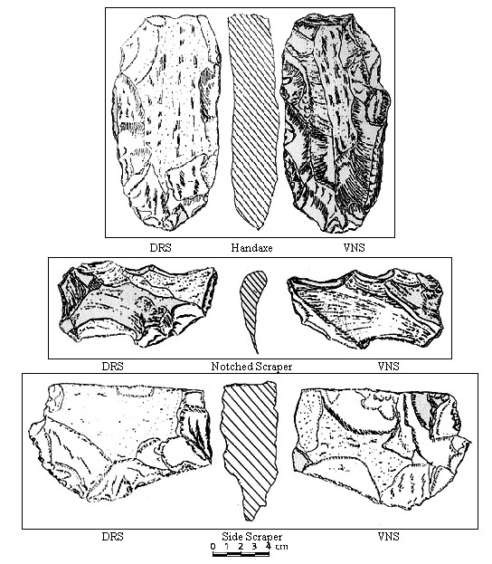
Prehistoric tools

Slide 4
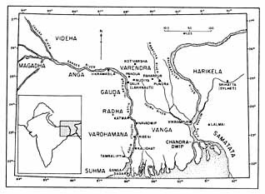
Cultural regions of Ancient Bengal

Slide 5
Ancient Bengal Janapadas
Bengal was split up into several independent kingdoms, completely unifying only several times. In ancient times, Bengal consisted of the kingdoms of Vanga, Pundra, Suhma, Anga, Samatata and Harikela.
The Vanga: The Vanga is an ancient human settlement situated in Eastern Bengal. But its geographical connotation varied in different periods of history. The Hindu literatures indicate that the Vanga is sea-faring nation and its realm extended up to the sea. They also mentioned that this is an area where finest quality white & soft cotton fabrics were produced. There was a coastal area approachable from the sea in the territory of Vanga. From the above mentioned references, Vanga appears to be an area of south and southeastern part of present Bangladesh.

Slide 6
Janapadas
The Pundra The Pundra or Pundranagara is the earliest urban centre in Bangladesh, which goes back to the 4th century BC. The ruins of this have been identified at Mahasthan in Bogra district. It continued to be the headquarters of the administration of Maurya, Gupta and Pals. It was the capital of Pundrabardhan Bhukti under the Gupta rule. Pundra was situated on the western bank of the Karatoya. It was well connected with other parts of Bengal through land and river routes. For this connection it was an important centre of trade and commerce throughout the ancient period. Pundra continued its importance after the Hindu regime and in the early Muslim period. The famous Muslim saint Shah Sultan Balkhi Mahisawar established his Khankah here.

Slide 7
Janapadas
The Gauda As an ancient human settlement, Gauda is the important Janapad of Bengal. The discovered evidence suggests that ancient Gauda located at coastal region. The famous & the first independent ruler of Gauda is Shashanka. He ruled Gauda at the 7th century AD and his capital was the Karnasuborna which is located at present Murshidabad district. The Janapad of Gauda lay to the west of Bhagirathi and that its core area was Murshidabad. In the 13th century, under the Sultans, Gauda denoted the entire area of the Muslim sultanate. Its capital also called Gaur or Lakhnaboti, located at present Chapai Nawabgonj district.

Slide 8
Janapadas
The Radha (ra-ro) Radha is the ancient human settlement of Bengal. It is difficult to locate exactly its geographical position. But historical sources suggest that Radha is the west-southern part of ancient Bengal. Howrah, Hughli and Burdwan in West Bengal are some areas of ancient Radha. The Somotata Samatata is an ancient territorial unit in ancient Bengal. Chinese traveler Hiuen-tsang visited Samatata at 7th century AD. As per his account, it was the South-eastern part of Bengal and was a Buddhist cultural centre. The archaeological discoveries in the Lalmai-Mainamati area, it can now be stated with certainty that Samatata was formed at Comilla-Noakhali areas and the adjacent parts of hilly Tripura.

Slide 9
Janapadas
The Harikel Harikel is another geographical entity in ancient Bengal. But it is so difficult to locate it. Most of the evidence support that Harikel is the similar with our present Sylhet region. Another archeological evidence suggests its location at present Chittagong district. Harikel was situated by the side of Samatata.

Slide 10
Ancient Bengal
Bengal is a 4,000 year old civilization that thrived between the banks of Ganges to Brahmaputra and sustained itself with the riches of Gangetic Delta.
Remnants of earliest cities in the state date back to the Vedic Period. The oldest archaeological sites in Bangladesh are Mahasthangarh and Wari-Bateshwar, which dates back to 700 B.C. and 600 B.C. The culture and ethnicity of Bengal was different than that of the Vedic people.

Slide 11
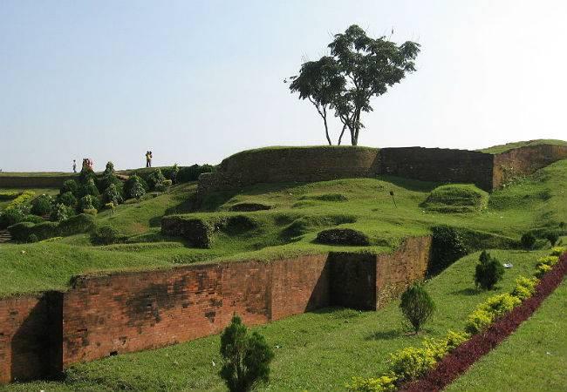
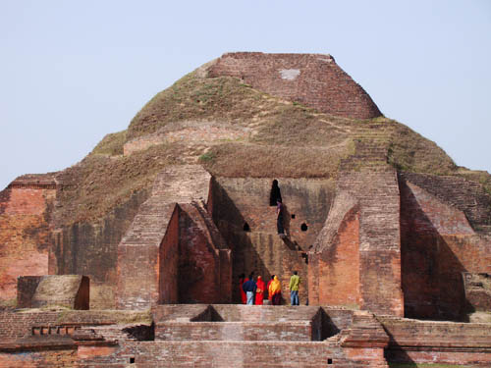
Paharpur Mahastangarh

Slide 12
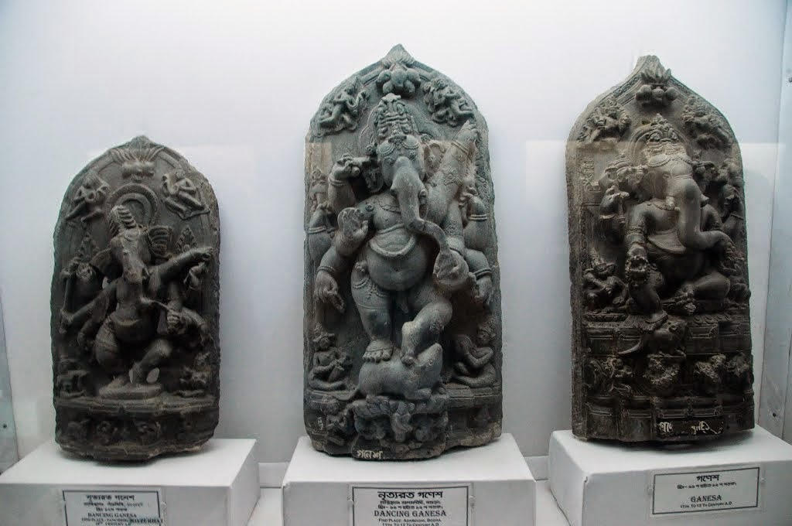
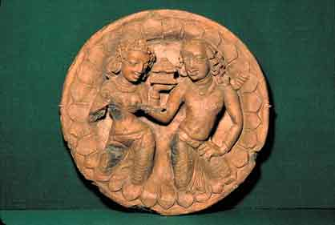
Artifacts of Mahasthangarh

Slide 13
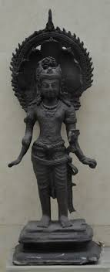
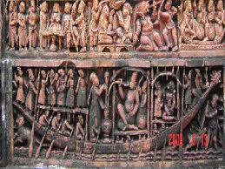
Artifacts of Mahasthangarh

Slide 14
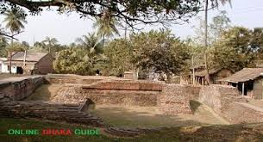
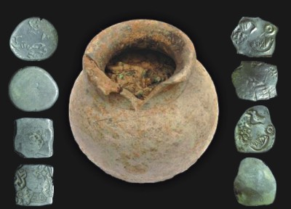
Wari-Bateshwar

Slide 15
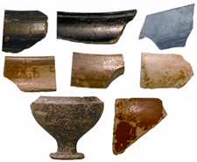
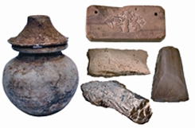
Wari-Bateshwar

Slide 16
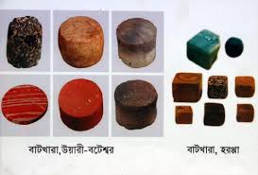
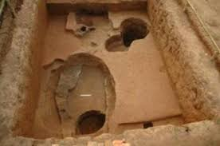
Wari-Bateshwar

Slide 17
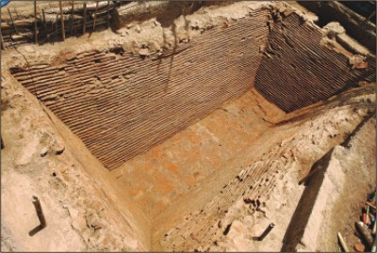
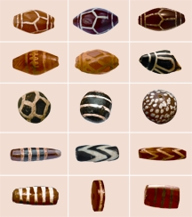
Wari-Bateshwar

Slide 18
Ancient Dynasties of Bengal
Maurya Dynasty (324 BC - 185 BC)
Chandragupta Maurya unified all Indian provinces, except the North-East, Tamil and Kalinga. His empire spanned from Bengal to Baluchistan. During his reign, Bengal flourished with riches and its naval fleet got stronger.
Gauda Empire (590 CE - 626 CE)
After the Mauryan Empire, other kingdoms and dynasties such as the Gupta, Kanvas, Shungas ascended to the throne of Bengal. But it was during the rule of King Shashanka that Bengal witnessed another flourishing period. Shashanka was a strong ruler who developed Bengal's architecture and calendar. He is infamous for oppressing Buddhist communities and driving them out of Bengal. Shashanka's capital, Karna Suvarna is now known as Murshidabad.

Slide 19
Ancient Dynasties of Bengal
Pala Empire (750 CE - 1200 CE)
Often dubbed as the 'Golden Age' of Bengal, the Pala Empire indeed raised the standards of Bengal's culture and politics. Followers of Buddhist philosophy, the Pala kings promoted classical Indian philosophy, literature, painting and sculpture studies. It was during this period that the Bengali language was formed in its entirety. Epics and sagas were written such as the 'Mangal Kavyas'. The Palas were also known for their war elephant cavalry and strong naval fleet.

Slide 20
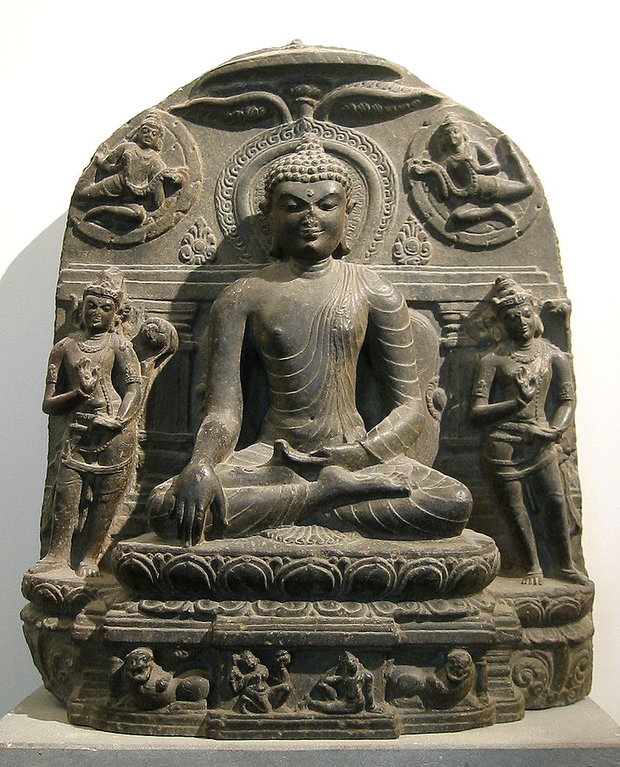
Gautama Buddha and Bodhisattvas, 11th century, Pala Empire

Slide 21
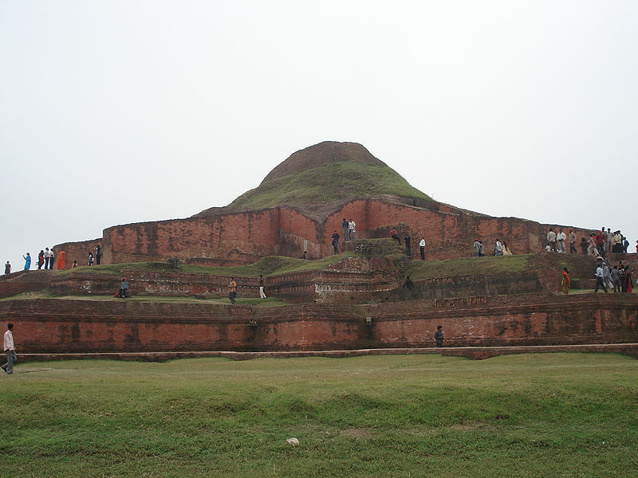
Somapura Mahavihara, the greatest Buddhist vihara in the Indian subcontinent, built by Emperor Dharmapala.

Slide 22
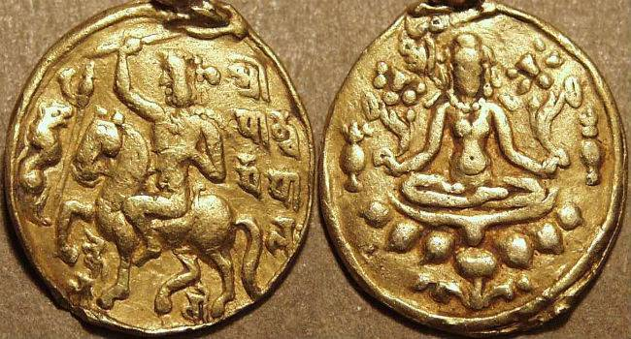
Pala coins

Slide 23
Ancient Dynasties of Bengal
Chandra Dynasty
The Chandra dynasty were a family who ruled over the kingdom of Harikela in eastern Bengal (comprising the ancient lands of Harikela, Vanga and Samatala) for roughly a century and a half from the beginning of the 10th century CE. Their empire also encompassed Vanga and Samatala, with Srichandra expanding his domain to include parts of Kamarupa. Their empire was ruled from their capital, Vikrampur (modern Munshiganj) and was powerful enough to militarily withstand the Pala Empire to the north-west. The last ruler of the Chandra Dynasty Govindachandra was defeated by the south Indian Emperor Rajendra Chola I of the Chola dynasty in the 11th century. Then it was under rule of Keshari dynasty of Utkal and subsequently under Ganga Dynasty of Kalinga followed by Surya dynasty of Kalinga till 1568 .

Slide 24
Ancient Dynasties of Bengal
Sena Empire
The Pala dynasty was followed by the Sena dynasty, who brought Bengal under one ruler during the 12th century. Vijaya Sena, second ruler of the dynasty, defeated the last Pala emperor, Madanapala, and established his reign.
Ballala Sena introduced caste into Bengal and made Nabadwip his capital.
The fourth Sena king, Lakshmana Sena, expanded the empire beyond Bengal to Bihar, Assam, Odisha and likely Varanasi. Lakshmana was later defeated by the Muslims and fled to eastern Bengal, where he ruled few more years. The Sena dynasty brought a revival of Hinduism and cultivated Sanskrit literature in India. It is proposed by some Bengali authors that Jayadeva, the famous Sanskrit poet and author of Gita Govinda, was one of the Pancharatnas or "five Gems" of the court of Lakshmana Sena.

Slide 25
Ancient Dynasties of Bengal
Deva Kingdom
The Deva Kingdom was a Hindu dynasty of medieval Bengal that ruled over eastern Bengal after the collapse Sena Empire. The capital of this dynasty was Bikrampur in present-day Munshiganj District of Bangladesh. The inscriptional evidences show that his kingdom was extended up to the present-day Comilla–Noakhali–Chittagong region. A later ruler of the dynasty Ariraja-Danuja-Madhava Dasharatha-Deva extended his kingdom to cover much of East Bengal.The end of this dynasty is not yet known.

